Slide 1
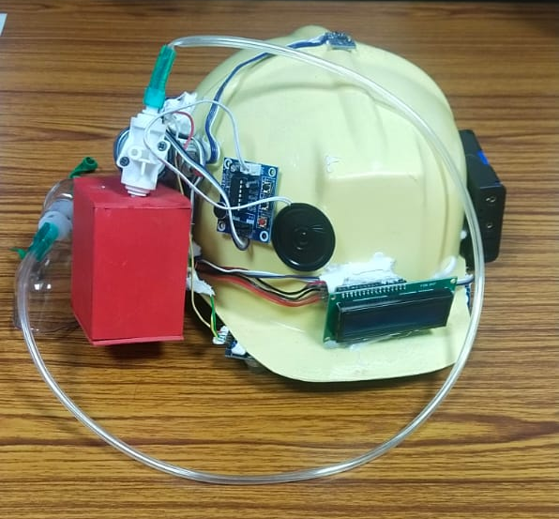
DEVELOPMENT OF HYBRID COMPOSITES USING BANANA FIBER AND GLASS FIBER FOR HELMET APPLICATION AND HARMFUL GAS DETECTION
PRESENTED BY,
Sridharshan . s
Mukesh.t
Bumeeswar .s

Slide 2
Abstract
Technology has improved to the point where more environmentally friendly materials are viable options. Particularly the Natural fibers and their composites involves in the environmental issues while also offering renewable potential. Natural fibers are increasingly being employed instead of man-made composites since they are more easily accessible and inexpensive. Banana and glass fibers were employed as reinforcement in this article.The Safety helmets are protective headgear designed to reduce the risk of injury in the event of an accident. They provide protection against impacts, falls, and debris. A hybrid helmet is a combination of banana fiber and glass fiber that provides superior protection and comfort. It is designed to be lightweight yet strong and flexible, making it ideal for a variety of activities. This paper revolves around development of hybrid helmet using banana fiber and glass fiber.

Slide 3
CLAIMS
The banana fiber is converted into powder form by the pulverizer.
There are three trials based on the composition of fibers and epoxy resin can be performed
The trails shows the biodegradability and mechanical behaviour of hybrid composite.
By the process of compression molding the helmet is manufactured.

Slide 4
Flowchart/ Product workflow
Collecting Raw Materials (BANANA FIBERS) directly from the farmers
Converting Raw Material to the desired form (Banana fiber powder, Glass fiber and polyester resin)
Testing their properties according to the standards of the ISI
Processing the Materials and compression molding it to HELMET
Production of ”HYBRID BIO FIBER HELMETS”

Slide 5
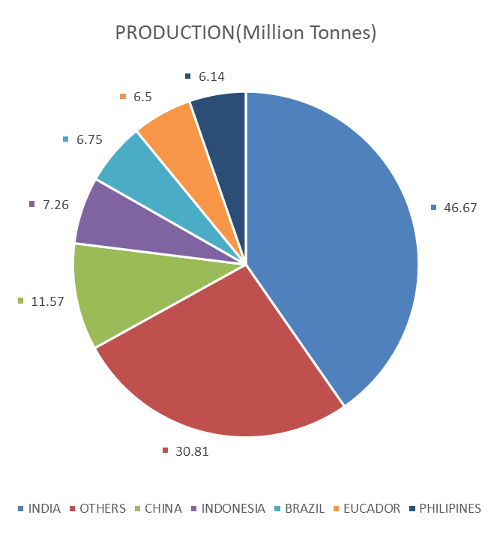
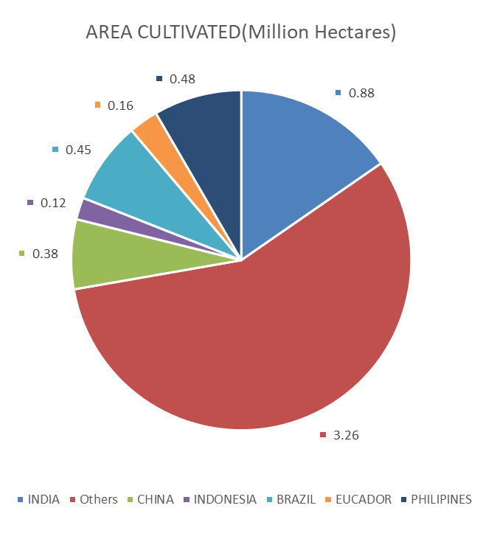
Availability Of Banana fibre

Slide 6
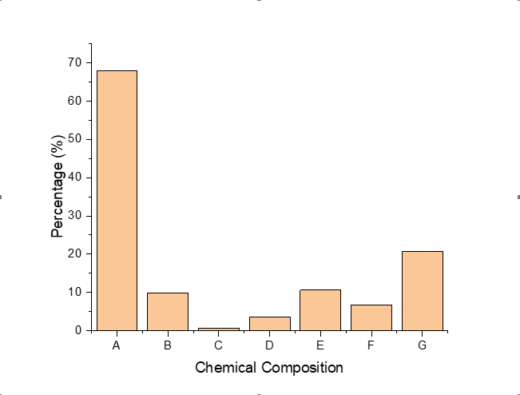
Chemical Composition of Banana Fiber
A | Cellulose
B | Lignin
C | Wax
D | Ash
E | Moisture
F | Pectin
G | Hemi cellulose

Slide 7
Thermal Stability Analysis For banana Fibre

Slide 8
Materials
Banana Fibre
Glass Fibre
Epoxy Resin
Where 1st and 2nd trail shown similar Mechanical Properties.
1st trail have increased degradability and Recyling Properties.
Methods
Formulation | EPOXY RESIN | BANANA FIBRE | GLASS FIBRE
1ST TRAIL | 50% | 25% | 25%
2ND TRAIL | 50% | 15% | 35%
3RD TRAIL | 50% | 35% | 15%

Slide 9
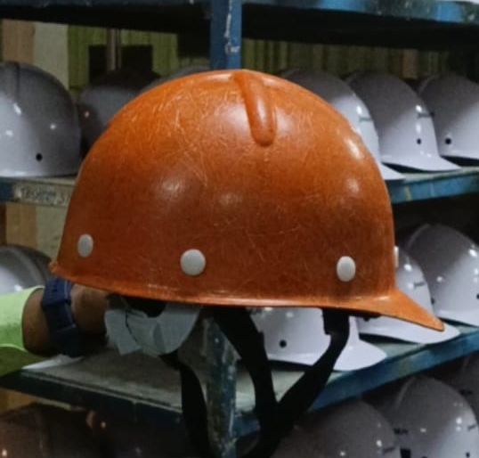
BANANA FIBER HELMET
Formulation | EPOXY RESIN | BANANA FIBRE | GLASS FIBRE
1ST TRAIL | 50% | 25% | 25%

Slide 10
Customers
Safety Helmet is used worldwide it can be sold by business to business and business to customer through online and offline
Safety Helmets are used majorly by working staffs on construction sites and production units and Onsite workers.

Slide 11
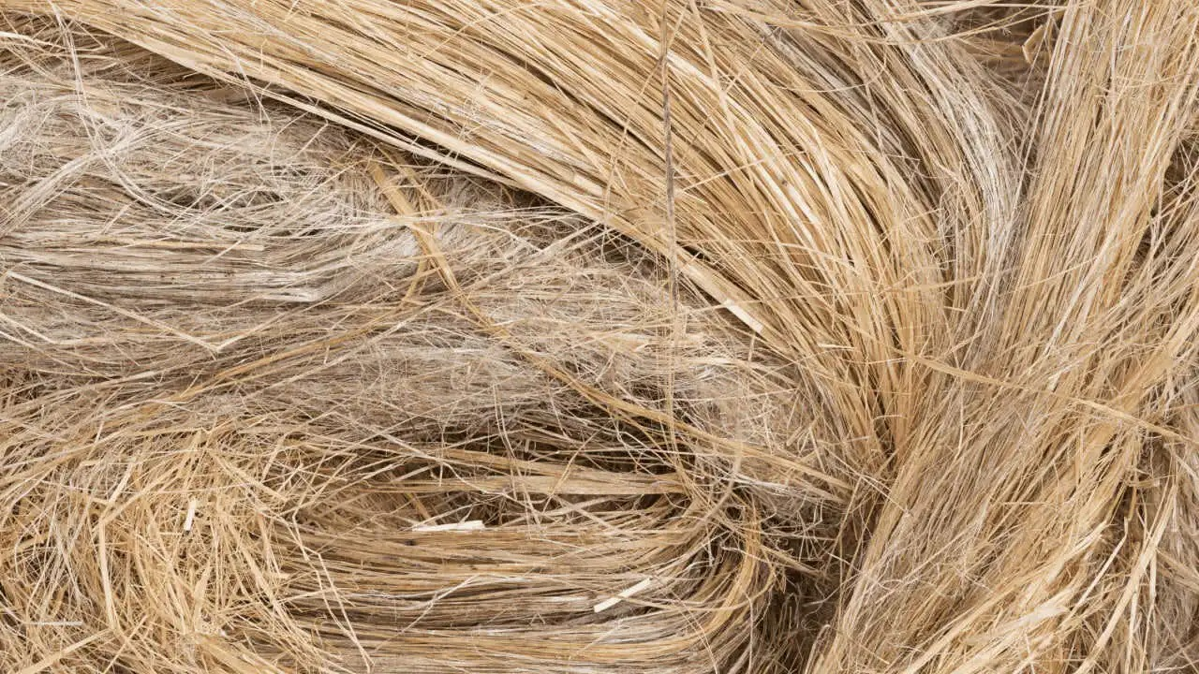
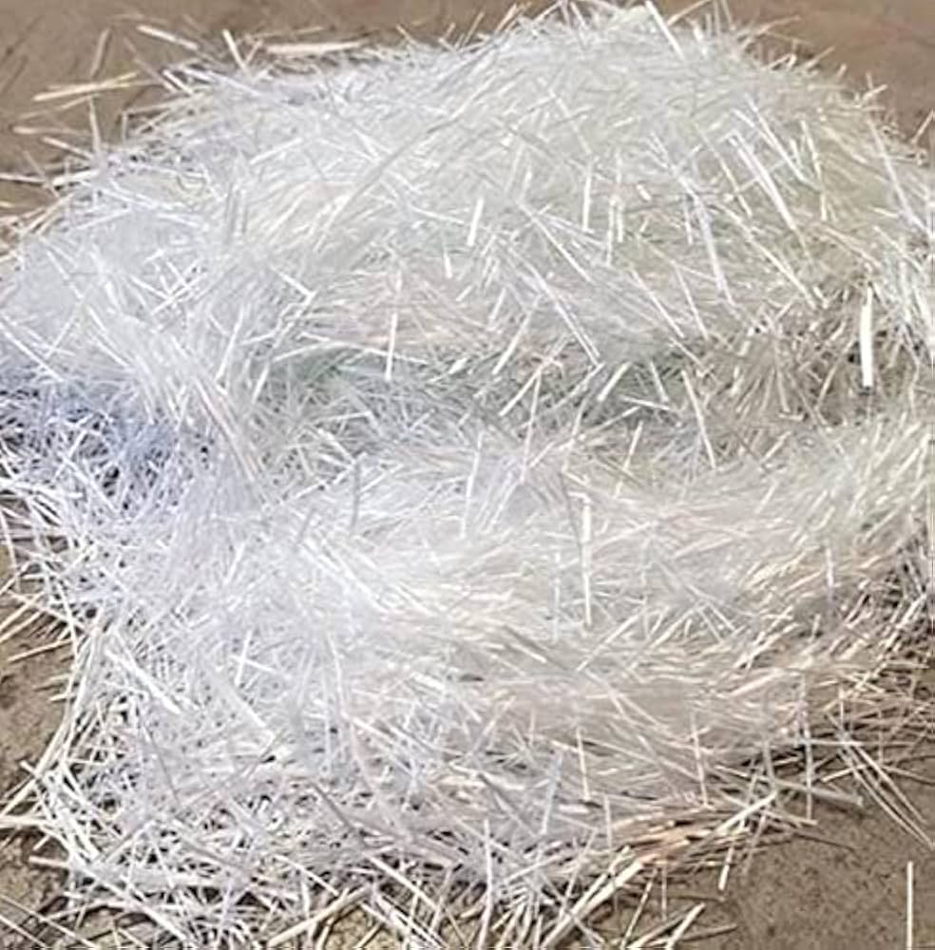
MATERIAL HYPOTHESIS
Helmets fabricated with banana fiber and glass fiber composites will exhibit superior impact resistance, lightweight properties, and mechanical strength compared to traditional glass fiber-reinforced helmets.

Slide 12
IOT HYPOTHESIS
The integration of smart sensors (e.g., accelerometers and helmet switches) will provide real-time monitoring and improve the safety compliance of miners, thereby reducing the risk of accidents and injuries in mining operations. This dual approach of material innovation and technological integration is expected to set new benchmarks in safety helmet design for hazardous industries.

Slide 13
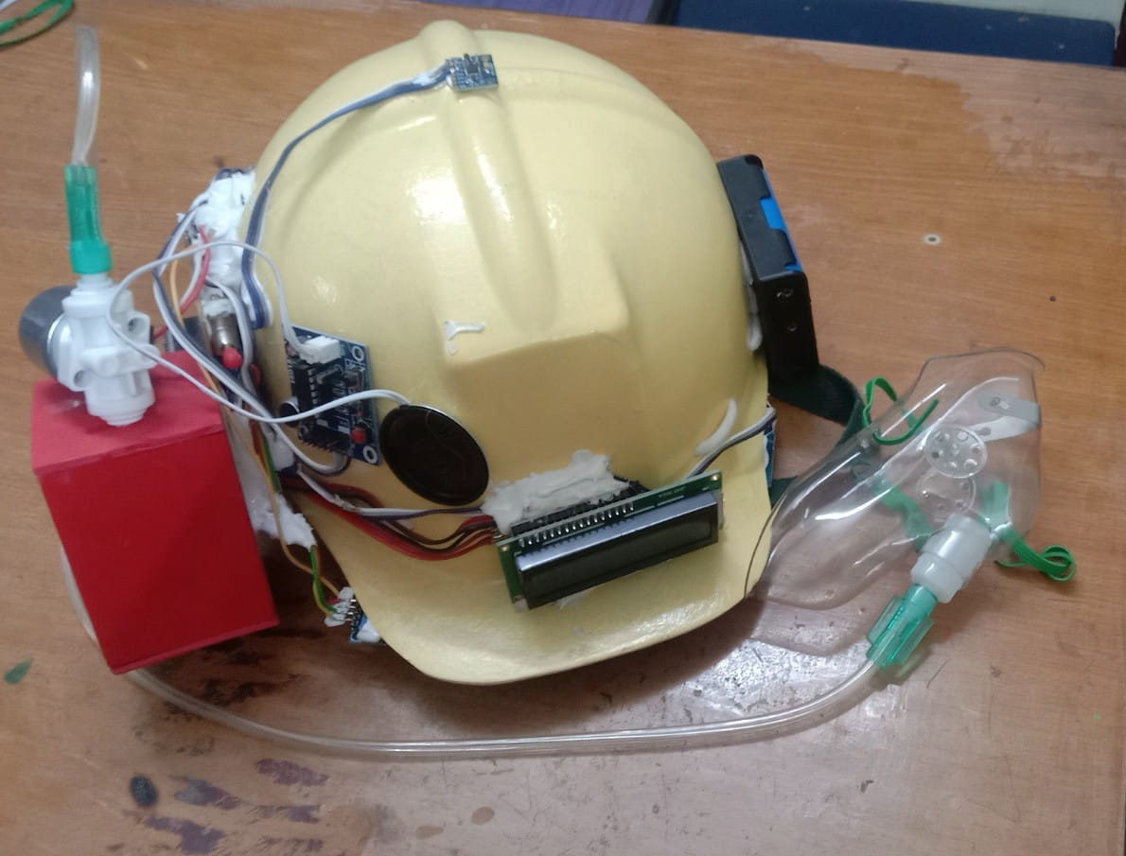
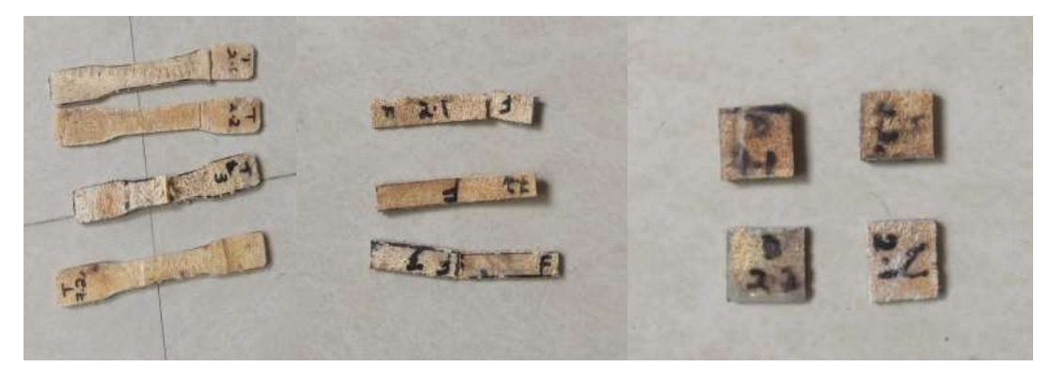
OBJECTIVES/INNOVATION
1. Develop a lightweight, impact-resistant helmet using banana fiber and glass fiber composites for enhanced miner safety. Integrate IoT-enabled sensors for real-time monitoring of helmet usage, head movements, and orientation.

Slide 14
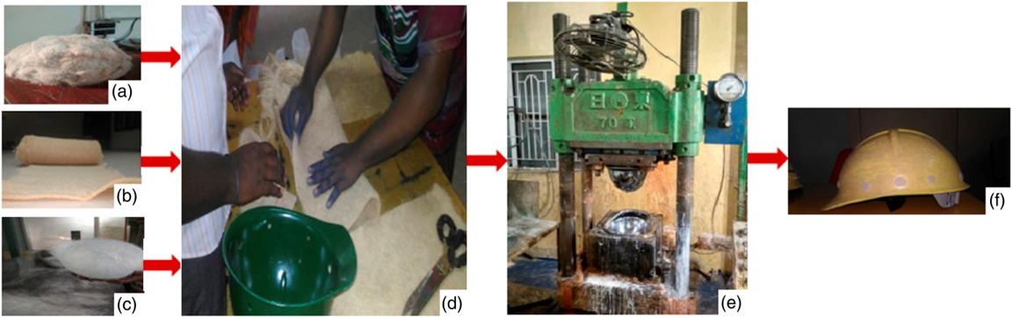
2.Sustainability through Natural Fibers: By using banana fibers, which are biodegradable and sustainable, this project pushes the boundaries of eco-friendly materials in industrial safety gear, promoting green manufacturing practices in the mining sector. The helmet’s integrated intelligent system aims to ensure safety standards are consistently met, offering a significant improvement in monitoring and maintaining safety compliance within hazardous mining environments.

Slide 15
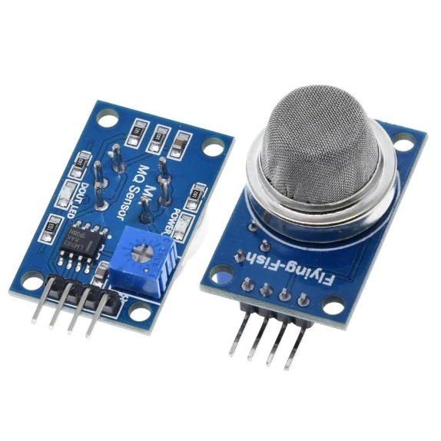
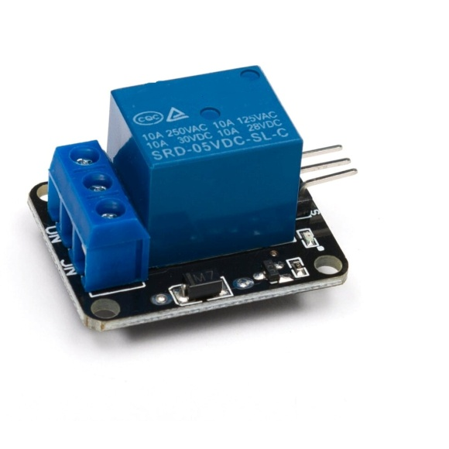
METHODOLOGY
• Assuring miners safety in caseof mining accidents that occursdue to Hazardous events.
• Alerting the miners wheneverthe helmet is removed-helmetswitch sensor to detect theobject-Accelerometer sensor.
• To monitor the conditions insidethe mines and intimate theminers in case of temperatureincreases-Temperature sensor.
• Detection of the poisonousgases-Air quality sensor.The MQ-5 gas sensor is frequently used to identify dangerous gases like natural gas, propane (C3H8), and methane (CH4). It belongs to the Figaro company's line of gas sensors and is commonly used in air quality monitoring and gas leak detection applications.

Slide 16
SOCIAL IMPACT / ADVANTAGES
Improved Miner Safety: Real-time monitoring and IoT-enabled alerts enhance safety and reduce accident risks.
• Sustainable Technology: Eco-friendly banana fibers lower the environmental impact of mining safety gear.
• Cost-Effective Solution: Affordable and scalable design ensures global accessibility for mining industries.
• Enhanced Compliance: Smart features promote adherence to safety standards, reducing injuries and boosting efficiency.

Slide 17
CONCLUSION
The banana fiber and glass fiber composite helmet, combined with IoT-enabled safety features, offersenhanced impact resistance, lightweight design, and real-time monitoring, significantly improvingminer safety in hazardous environments. This eco-friendly innovation promotes sustainability,workplace safety, and adherence to safety standards, contributing to miner well-being andsustainable mining practices.

